Slide 2
OHM’S LAW
Project number: 2021-1-DE02-KA220-VET-000029587
PR3/A2: Self-training material for enriching current online experiments
This work is licensed under a Creative Commons Attribution – NonCommercial – ShareAlike 3.0 License.
Funded by the European Union. Views and opinions expressed are however those of the author(s) only and do not necessarily reflect those of the European Union or the European Education and Culture Executive Agency (EACEA). Neither the European Union nor EACEA can be held responsible for them.

Slide 3
CONTENT
01
11
Ohm’s law
Ohm’s law pie chart
02
12
Ohm’s law explanation
Ohm’s law matrix table
03
13
Applications of Ohm’s
law
Ohm’s law formula
04
14
Calculating electrical power using Ohm’s law
Ohm’s law graph
05
15
Limitations of Ohms law
Ohm’s law unit
06
16
Analogies of Ohm’s Law
Ohm’s law equations
07
Relationship between Voltage, Current, and Resistance
08
Ohm’s law triangle
09
Vector form of Ohm’s law
10
Experimental verification of Ohm’s law

Slide 4
OHM’S LAW
Ohm’s Law asserts that the voltage across a conductor is directly proportional to the current passing through it, as long as the physical conditions and temperature remain constant. Therefore, according to Ohm’s Law, the current through a conductor is directly proportional to the voltage across it, expressed as V ∝ I. This principle establishes the fundamental relationship between the applied voltage and the resulting current in the conductor, making it a cornerstone for understanding and working with electrical circuits. Ohm’s Law indicates that the current exhibits a linear relationship with the voltage.

Slide 5
OHM’S LAW EXPLANATION
Ohm’s Law is one of the fundamental laws of electrostatics which state that, the voltage across any conductor is directly proportional to the current flowing in that conductor. We can define this condition as:
Removing the proportionality sign:
where R is the proportionality constant and is called the Resistance of the material. The resistance of the material is calculated as,
V = RI
R = V/I
V ∝ I
Resistance is measured in Ohms. It is denoted by the symbol Ω.

Slide 6
OHM’S LAW FORMULA
When all physical parameters and temperatures remain constant, Ohm’s law states that the voltage across a conductor is directly proportional to the current flowing through it.
Ohm’s law can be expressed as:
V ∝ I or V = I × R
Where:
R is the Constant of proportionality known as Resistance,
V is the Voltage applied, and
I is the current flowing through the electrical circuit.
The above formula can be rearranged to calculate current and resistance also, as follows:
According to Ohm’s law, the current flowing through the conductor is,
I = V / R
Similarly, resistance can be defined as,
R = V / I

Slide 7
OHM’S LAW GRAPH
Ohm’s law is valid only when physical conditions, such as temperature, remain constant. This is because current flow through the circuit can be affected by changes in temperature. Therefore, when factors like temperature change, Ohm’s law may not hold true. For instance, in a light bulb, the temperature increases as the current flowing through it rises, causing a deviation from Ohm’s law.

Slide 8
OHM’S LAW UNIT
Physical Quantity | Unit of Measurement | Unit Abbreviation
Current(C) | Ampere | A
Voltage(V) | Volt | V
Resistance(R) | Ohm | Ω
Three physical quantities:
Current
Voltage
Resistance

Slide 9
OHM’S LAW EQUATIONS
Ohm’s law provides three equations which are:
V = I × R
I = V / R
R = V / I
Where:
V is the voltage
I is the current
R is the resistance

Slide 10
RELATIONSHIP BETWEEN VOLTAGE, CURRENT, AND RESISTANCE
Voltage | Current | Resistance
2V | 1/2 A | 4 Ω
4V | 1A | 4 Ω
8V | 2A | 4 Ω
The relation between voltage, current, and resistance can easily be studied using the formula,
V = IR
Where:
V is the voltage
I is the resistance
R is the resistance

Slide 11
OHM’S LAW TRIANGLE
The Ohm’s law triangle is a visual aid designed to help understand and memorize the relationship between voltage, current, and resistance. This tool assists engineers in recalling the correct order of these three key elements: current (I), voltage (V), and resistance (R).

Slide 12
VECTOR FORM OF OHM’S LAW
The relation between current and voltage is established by, Ohm’s law, and its vector form is:
j = σ E
Then we know:
Resistance is directly proportional to the length of the resistor, i.e. R ∝ l, . . .(1)
Resistance is inversely proportional to the cross-section area of the resistor, i.e. R ∝ 1/A . . .(2)
Combining eq. (1) and eq.(2)
Where ρ is the proportionality constant called coefficient of resistance or resistivity.
Now if L = 1m and A = 1 m2, in the above formula we get,
R = ρ
This means for a resistor of length 1 m and cross-section area 1 m2 the resistance is called the resistivity of the material.
Where,
j is Current Density vector
E is Electric Field vector
σ is conductivity of material
Resistivity
The hindrance faced by the electrons while moving in any material is called the resistivity of the material. Let a resistor of a length of ‘l’ and the cross-sectional area of ‘A’ has a resistance be R.
R = ρl / A

Slide 13
EXPERIMENTAL VERIFICATION OF OHM’S LAW
Procedure
The key K is closed initially and the rheostat is adjusted such that the reading in ammeter A and voltmeter V is minimum.
The current is then increased in the circuit by adjusting the rheostat, and the current at various values of the rheostat and their respective voltage is recorded.
Now for different values of voltage(V) and current(I) and then calculate the ratio of V/I.
After calculating all the ratios of V/I for different values of voltage and current, we notice that the value is almost constant.
Now plotting a graph of the current against the potential difference we get a straight line. This shows that the current is directly proportional to the potential difference and its slope is the resistance of the wire.
Circuit Diagram

Slide 14
OHM’S LAW PIE CHART
To better understand the relationship between various parameters, we can take all the equations used to find the voltage, current, resistance, and power, and condense them into a simple Ohm’s law pie chart as shown below:

Slide 15
OHM’S LAW
MATRIX TABLE
Like Ohm’s law pie chart shown above, we can condense the individual Ohm’s Law equations into a simple matrix table as shown below for easy reference when calculating an unknown value.

Slide 16
CALCULATING ELECTRICAL POWER USING OHM’S LAW
Using the Ohm’s law, we can easily find the power of the electric circuit. The formula to calculate the electric power is:
P = VI
Where:
P is the power of the circuit
V is the voltage across the circuit
I is the current passing through the circuit
We know that, using Ohm’s Law
V = IR
Using the power formula we get,
P = V2/R
P = I2R

Slide 17
LIMITATIONS OF OHM’S LAW
ANALOGIES OF OHM’S LAW
The law of Ohm does not apply to unilateral networks. The current can only flow in one direction in unilateral networks. Diodes, transistors, and other electronic components are used in these sorts of networks.
Non-linear components are also exempt from Ohm’s law. Non-linear components have a current that is not proportional to the applied voltage, which implies that the resistance value of those elements varies depending on the voltage and current. The thyristor is an example of a non-linear element.
Water pipe analogy:
Electricity flows like water in pipes. More pressure (voltage) means more current (water flow), following Ohm's Law.
Temperature analogy
Similarly, a temperature circuit can also be compared to an ohmic conductor. Here, temperature gradient works similarly to voltage, and heat flow works similarly to current.

Slide 18
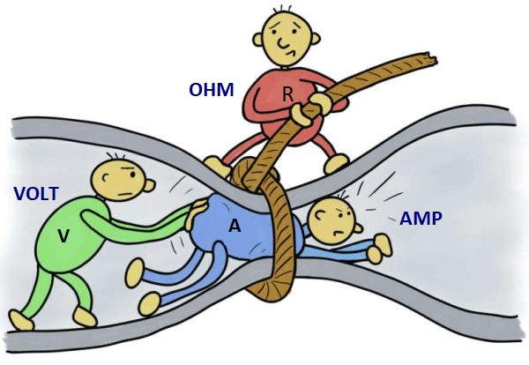
EDUCATIONAL VIDEOS
1. Ohm’s Law
2. Ohm’s Law Example
Source:
“Ohms Law” - The organic chemistry tutor
“Ohms Law Example” - Engineer4Free

Slide 19
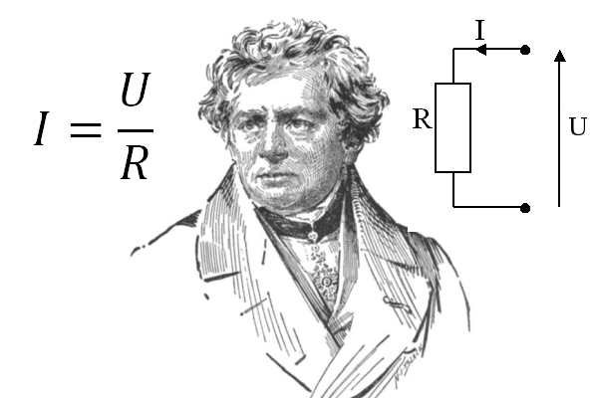
SELF-ASSESSEMENT
Scan me!

