Slide 2
HVAC SENSORS
Project number: 2021-1-DE02-KA220-VET-000029587
PR3/A2: Self-training material for enriching current online experiments
This work is licensed under a Creative Commons Attribution – NonCommercial – ShareAlike 3.0 License.
Funded by the European Union. Views and opinions expressed are however those of the author(s) only and do not necessarily reflect those of the European Union or the European Education and Culture Executive Agency (EACEA). Neither the European Union nor EACEA can be held responsible for them.

Slide 3
CONTENT
01
What is an HVAC?
02
Working of HVAC
03
History of HVAC
04
Applications of HVAC
05
Standard Components of HVAC
06
Additional components
07
Common types of HVAC systems
08
10 of the most common HVAC problems and how to fix them

Slide 4
WHAT IS AN HVAC?
Heating: during the winter months, HVAC systems offer heating. Furnaces, boilers, heat pumps, and electric heaters are common heating appliances. To increase the temperature indoors, these systems either produce or transfer heat.
Ventilation: it is the process of bringing fresh air into indoor spaces and removing stale air from them. It helps in fragrance control, dust removal, humidity regulation, and oxygen supply. Fans, air ducts, and air exchangers can all be used as ventilation systems.
Air conditioning: the process of cooling and dehydrating interior air is known as air conditioning. Typically, refrigeration cycles involving compression as well as expansion of gases called refrigerants are used to accomplish this. Central air conditioning units, split systems, window units, and portable air conditioners are a few types of air conditioning systems.
H
Heating
V
Ventilation
A
Air
C
Conditioning

Slide 5
WORKING OF HVAC
Heating: the HVAC system may include a furnace, boiler, heat pump, or electric heaters to provide heating. Heat is generated by the heating source and then dispersed around the room by the air-handling equipment.
Air distribution: the air that is conditioned (either heated or cooled) is pumped into the air handling unit and forced via the ducting system. To provide uniform circulation and temperature throughout the building, ducts transfer the air to various rooms or zones.
Air filtration: to get clear dust, allergies, and other airborne particles, air filters are put in the HVAC system. Capturing pollutants before the air is recirculated within the building, aid in preserving indoor air quality. Managing interior humidity levels is able to be done by adding humidifying devices or dehumidifiers to HVAC systems. In dry circumstances, humidifiers offer moisture to the air, and in humid ones, dehumidifiers take away extra moisture.
Exhaust systems: HVAC systems can include exhaust systems in certain rooms, such as kitchens and restrooms, that remove stale air, smells, and moisture to the outside.
Controls and sensors: in order to control temperature, humidity, and airflow, the HVAC system is often supplied with controls, sensors, and programming. These components maintain a close watch on the surroundings and alter how the system works.

Slide 6
HISTORY OF HVAC
Ancient civilizations: ancient peoples weren't strangers to temperature control! Egyptians used evaporative cooling, while Romans built hypocausts – raised floors with warm air flowing underneath.
18th century: industrial revolution brought heating and ventilation systems with steam boilers and radiators/pipes for heat distribution.
19th century: heating and ventilation kept improving. Thermostats (invented 1830) allowed for precise temperature control, and by the late 1800s, big buildings had central heating with gas or coal furnaces.
20th Century: forced-air and electric heating became popular for better control and efficiency. Plus, 1902 saw Willis Carrier invent the first modern air conditioner (originally for humidity control in printing), a major leap in cooling tech.
Post-World War II: after WWII, air conditioning became a household feature. Units shrank, prices dropped, and installation boomed.

Slide 7
APPLICATIONS OF HVAC
Residential buildings: in order to provide comfort for heating and cooling, systems are frequently employed in homes and apartments.
Commercial buildings: in commercial structures like offices, retail stores, restaurants, and hotels, systems are important.
Industrial facilities: industrial buildings, warehouses, and industrial plants frequently need specialized temperature and humidity management.
Educational institutions: HVAC systems are crucial for maintaining the comfort of classrooms and common areas for instructors, pupils, and staff in schools, colleges, and universities.
Hospitals use HVAC systems to control temperature, humidity, and air quality. This keeps patients comfortable, prevents germs from spreading, and keeps surgery rooms and labs sterile.
Data centers rely on precise HVAC cooling to remove heat and keep equipment running smoothly.
Laboratories and research facilities: in order to support scientific research, equipment, and sample integrity, HVAC systems offer accurate climate control.
Hospitality industry: HVAC systems are utilized in hotels, resorts, and other types of hospitality facilities to create pleasant guest rooms, common areas, and eating places.
Trains, buses, and other rides keep passengers comfy with HVAC systems for temperature control and fresh air.
Indoor sports venues use HVAC to keep athletes and audiences cool and comfortable.

Slide 8
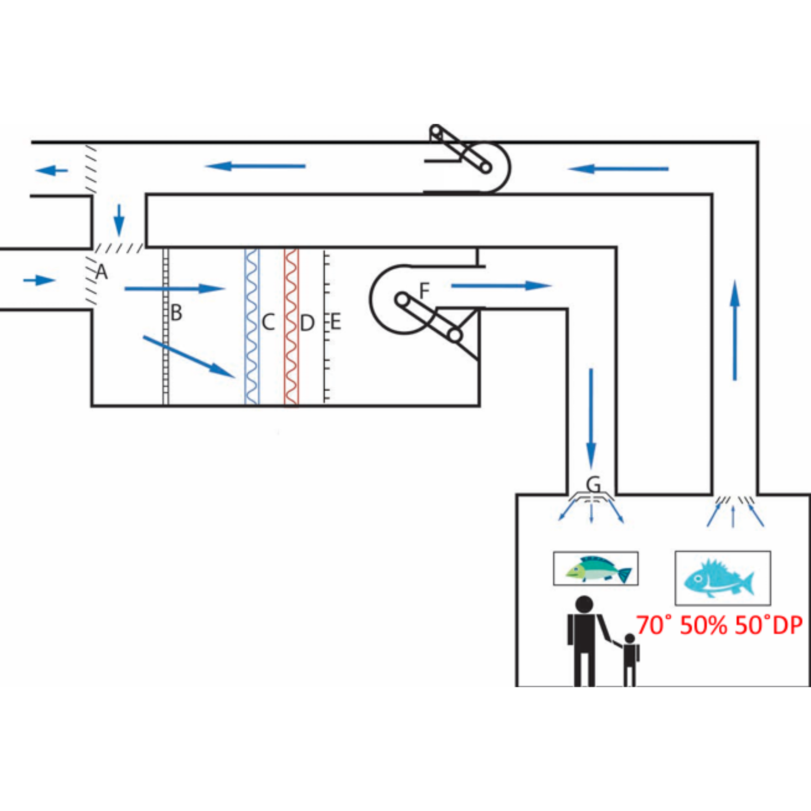
STANDARD COMPONENTS OF HVAC
Air
Handling System

Slide 9
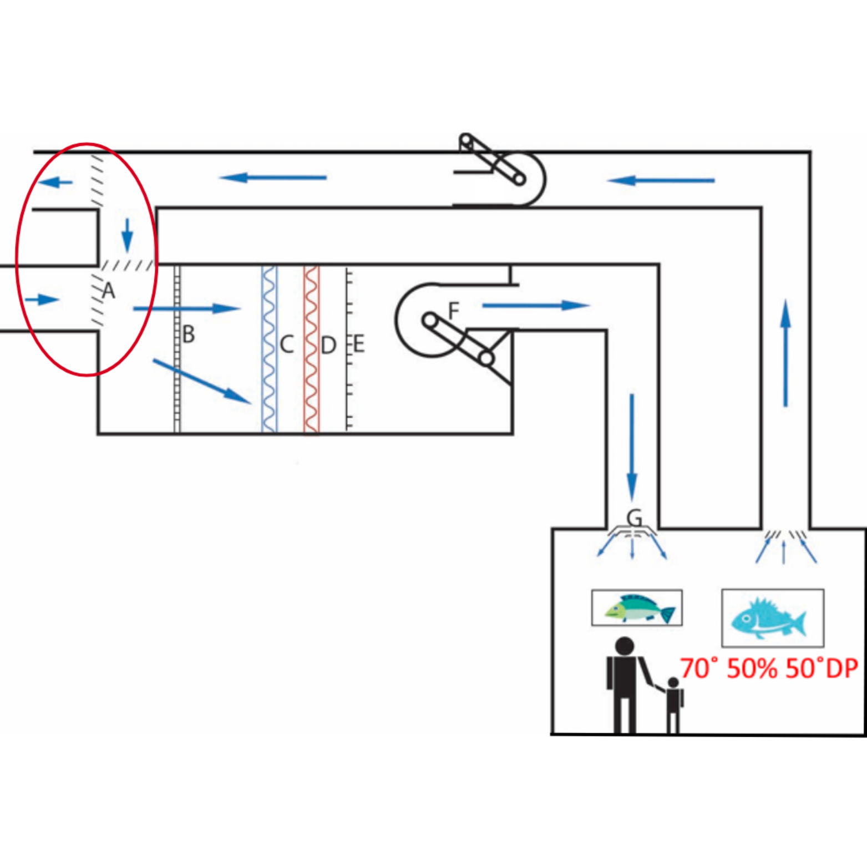
STANDARD COMPONENTS OF HVAC
Dampers (A)
Dampers are the metal doors inside ductwork that help regulate air flow. Can be manually controlled or can be controlled by motors or actuators that open or close them.

Slide 10
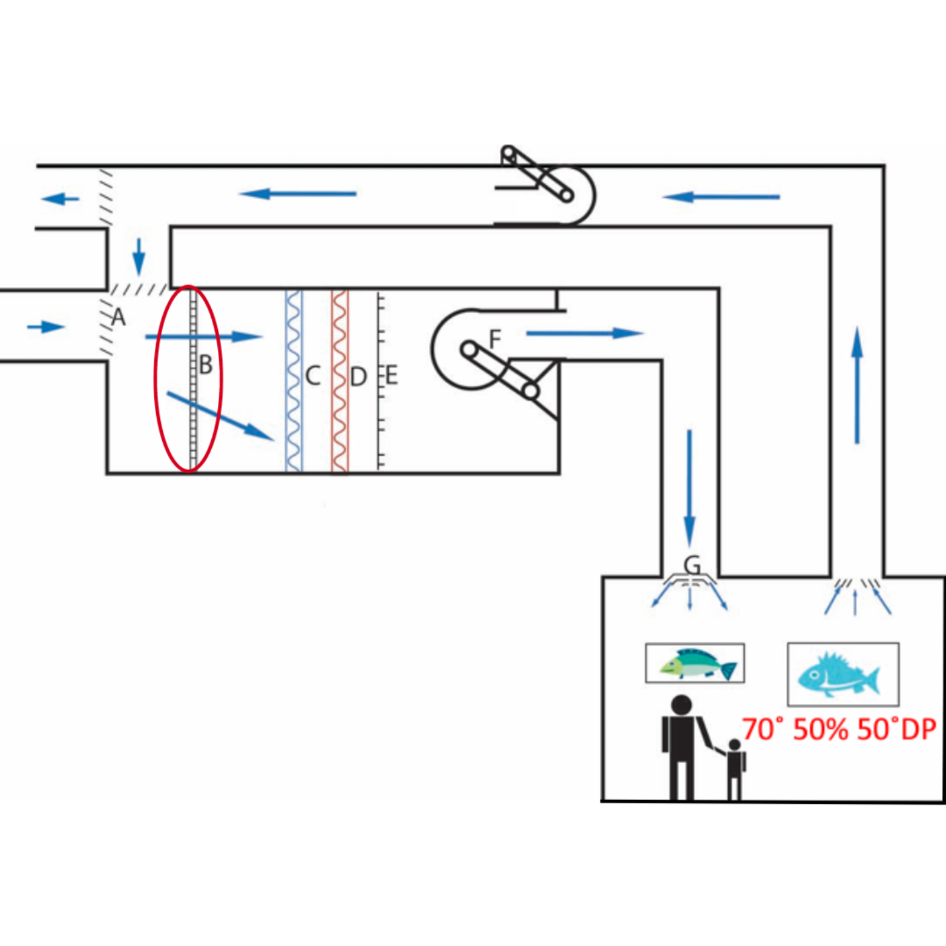
STANDARD COMPONENTS OF HVAC
Filters (B)
Designed to trap pollutants, dirt, dust, molds, bacteria etc., and to prevent these materials from entering the system and contaminating the environment. Filters can be made from felt, cloth, cellulose, fiberglass, foam, paper, silk, etc., and can filter out varying levels of contaminants based on their construction.

Slide 11
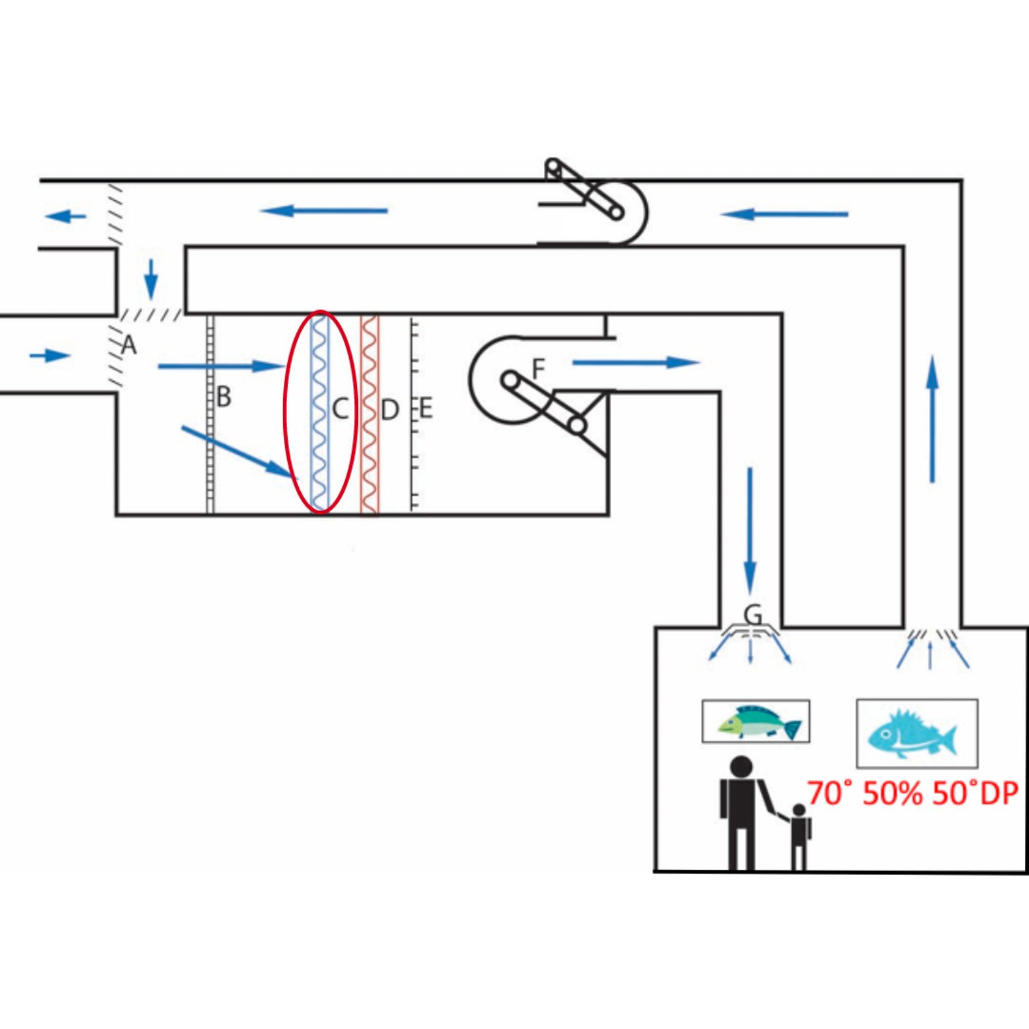
STANDARD COMPONENTS OF HVAC
Cooling coils (C)
Also known as evaporator coil connected to a source of cooled refrigerant, i.e. chiller, cooling tower, etc., these coils are used to absorb heat from the air that passes over them. Depending on the temperature of the water in the coil, they can cause condensation to occur when air with a higher dew point pass over it.

Slide 12
STANDARD COMPONENTS OF HVAC
Cooling coils (C)
Also known as evaporator coil connected to a source of cooled refrigerant, i.e. chiller, cooling tower, etc., these coils are used to absorb heat from the air that passes over them. Depending on the temperature of the water in the coil, they can cause condensation to occur when air with a higher dew point pass over it. Cooling coils can be broken down into two main types: standard fluid coils and refrigerant coils. Both achieve the same result of cooling incoming air, but are designed differently to accommodate the different cooling medium.

Slide 13
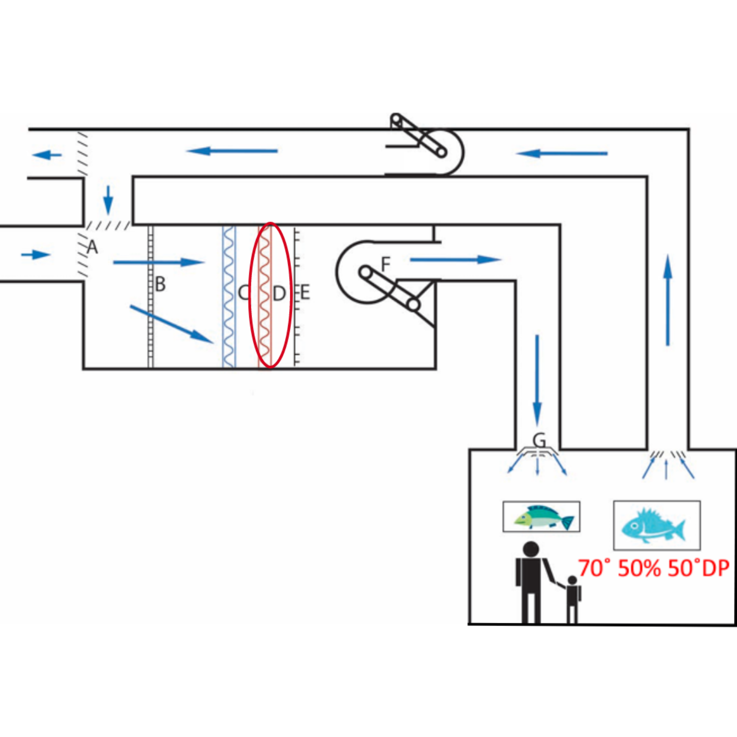
STANDARD COMPONENTS OF HVAC
Heating Coils/Reheats (D)
Connected to a heat source, i.e. boiler or electric heaters, these coils are used to reject heat to the air that passes over them.

Slide 14
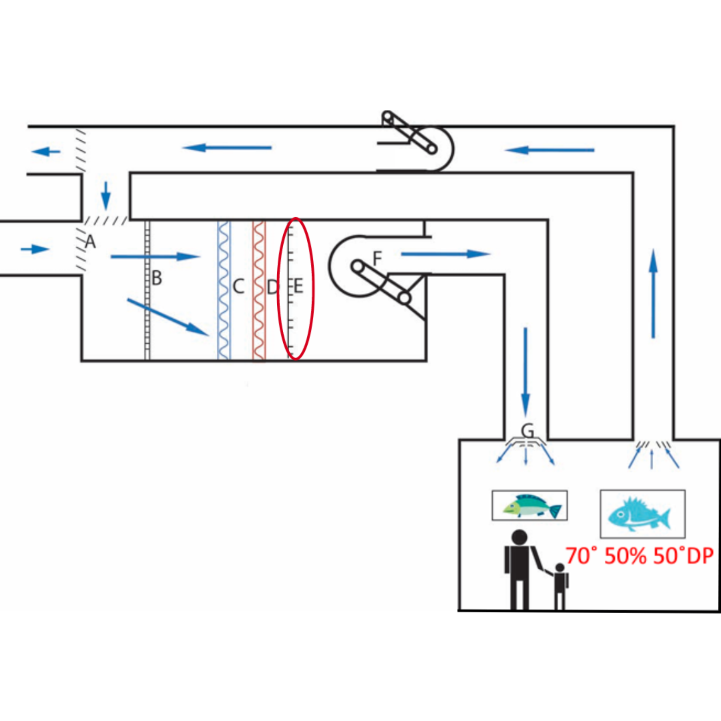
STANDARD COMPONENTS OF HVAC
Humidifiers (E)
A mechanism used to add moisture to the air. In HVAC settings there are four dominant methods for raising the moisture content of air.

Slide 15
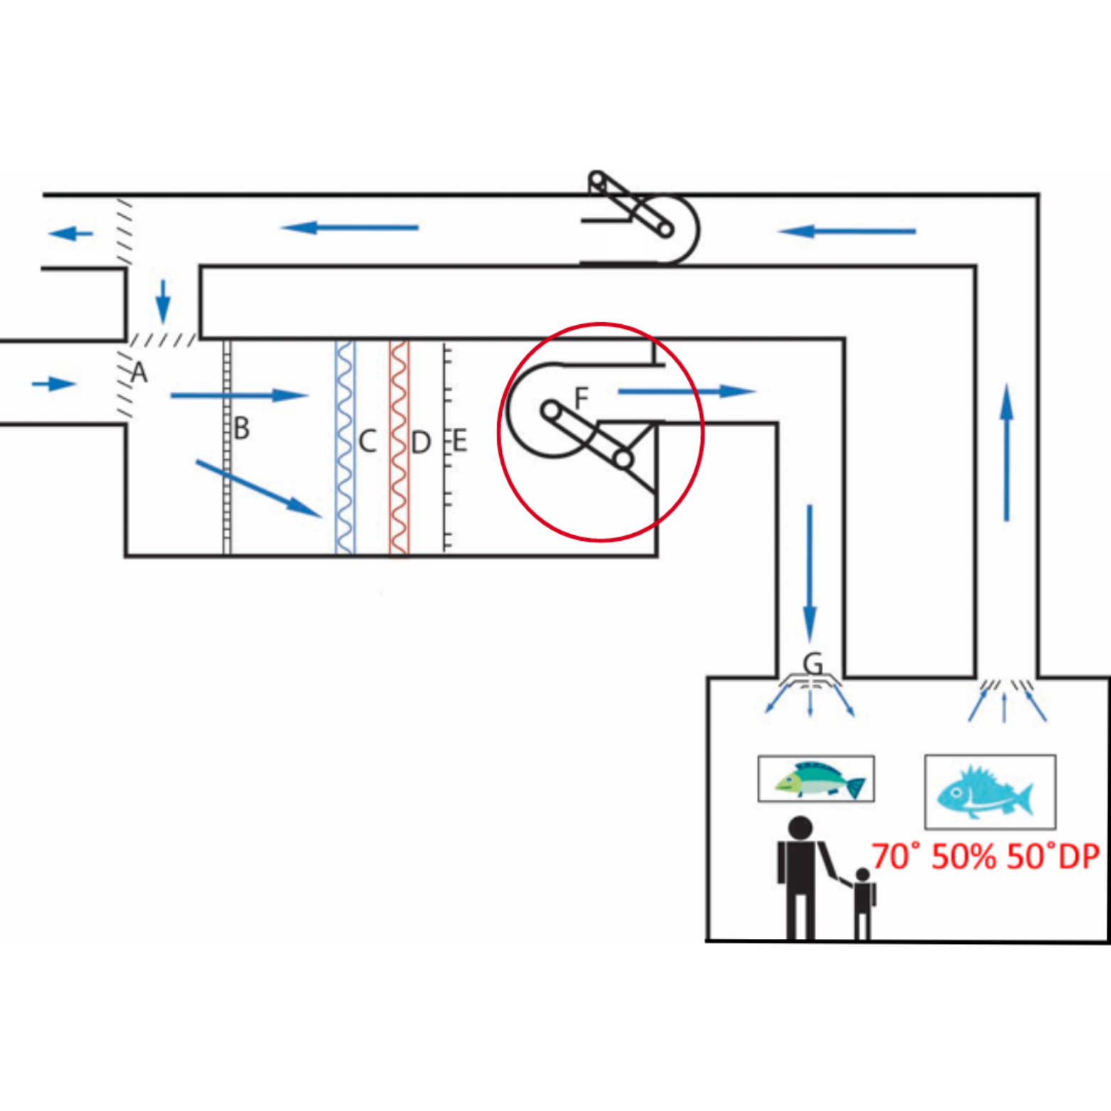
STANDARD COMPONENTS OF HVAC
Fans (F)
Fans are motor driven assemblies found inside of the air handling systems that help move air through the system.

Slide 16
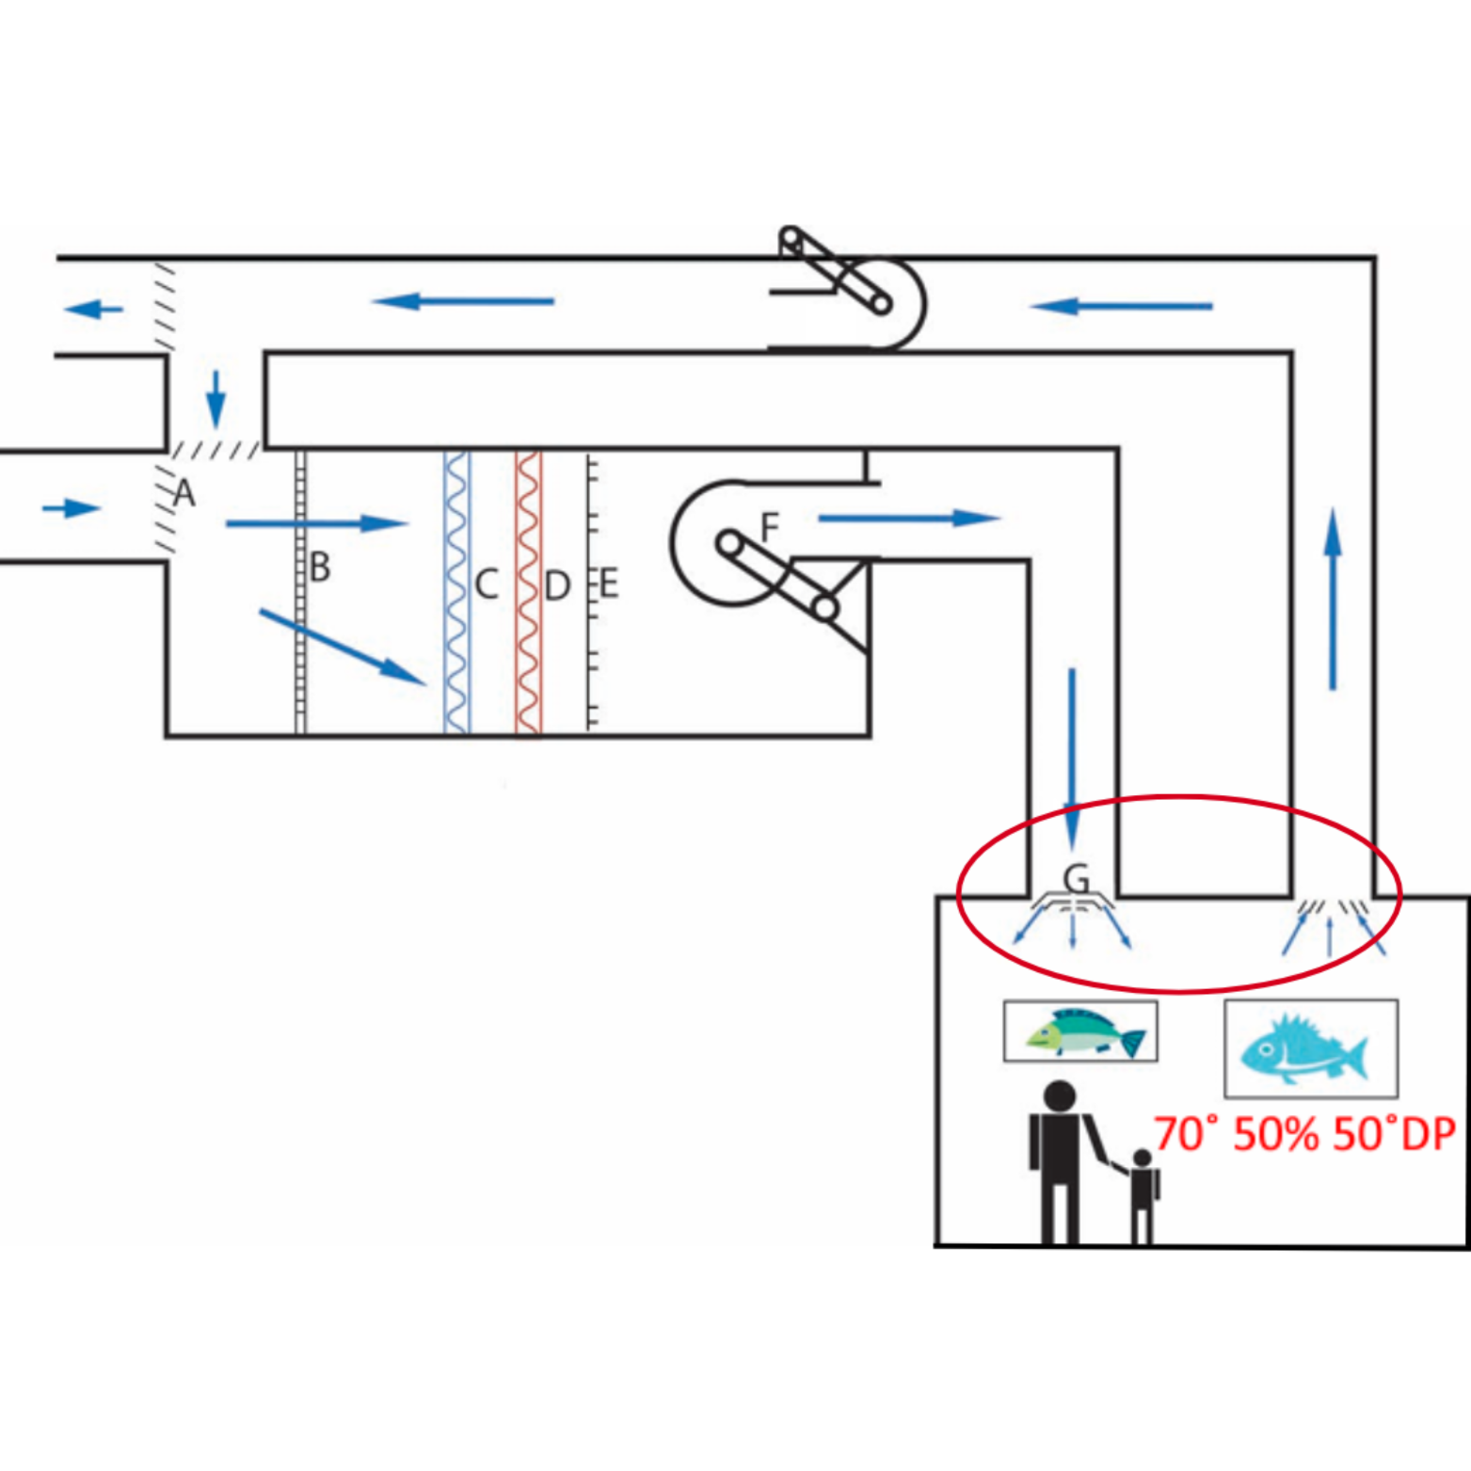
STANDARD COMPONENTS OF HVAC
Diffuser (G)
In HVAC systems, the air supply diffuser is a device that delivers and ventilates conditioned air in an area, mixes indoor air, and manages air output. It works by reducing the air duct velocity by increasing the static pressure.

Slide 17
Additional components
Turning vanes | Air mixer | Building management systems
Stationary metal devices inside duct work that are used to direct the flow of air and reduce turbulence in the ductwork. | Metal devices in an air handling unit that are used to mix or blend the passing air. Usually located after the outside air intake or after a bypass in the system. | The computer-based control system that can automate the HVAC, lighting, security, and life safety systems of a facility.
VFD | Desiccant air dryer | Open plenum design
Variable Frequency Drive (VFD) or Variable Speed Drive (VSD) - a digital control device used on air handling units to control the speed and torque of the supply, return, or relief fans in the unit. | A device that uses hygroscopic material to remove moisture from air that is drawn into it. | Air is returned to the HVAC system through the ceiling of the space without the use of ductwork. Ceiling air return can mix with unconditioned air, messing with temperature and humidity for your valuables.

Slide 18
Additional components
Controls/Stats | Controls/Stats | Economizing
Thermostat – an instrument used to regulate the temperature in a space. The device can activate the HVAC system to operate. Humidistat – an instrument used to regulate the relative humidity in a space. The device can activate the HVAC system to operate. Primarily the cooling coil and the humidifier or dehumidifier. Thermidistat – an instrument that is used to measure temperature and humidity in a space. The device can activate the HVAC system to operate. | Thermostat – an instrument used to regulate the temperature in a space. The device can activate the HVAC system to operate. Humidistat – an instrument used to regulate the relative humidity in a space. The device can activate the HVAC system to operate. Primarily the cooling coil and the humidifier or dehumidifier. Thermidistat – an instrument that is used to measure temperature and humidity in a space. The device can activate the HVAC system to operate. | An economizer is a part of a building’s cooling system that uses cool outdoor air to cool the building instead of operating the air conditioning components. This is typically employed when the outside air is cooler than the cooling set point temperature.

Slide 19
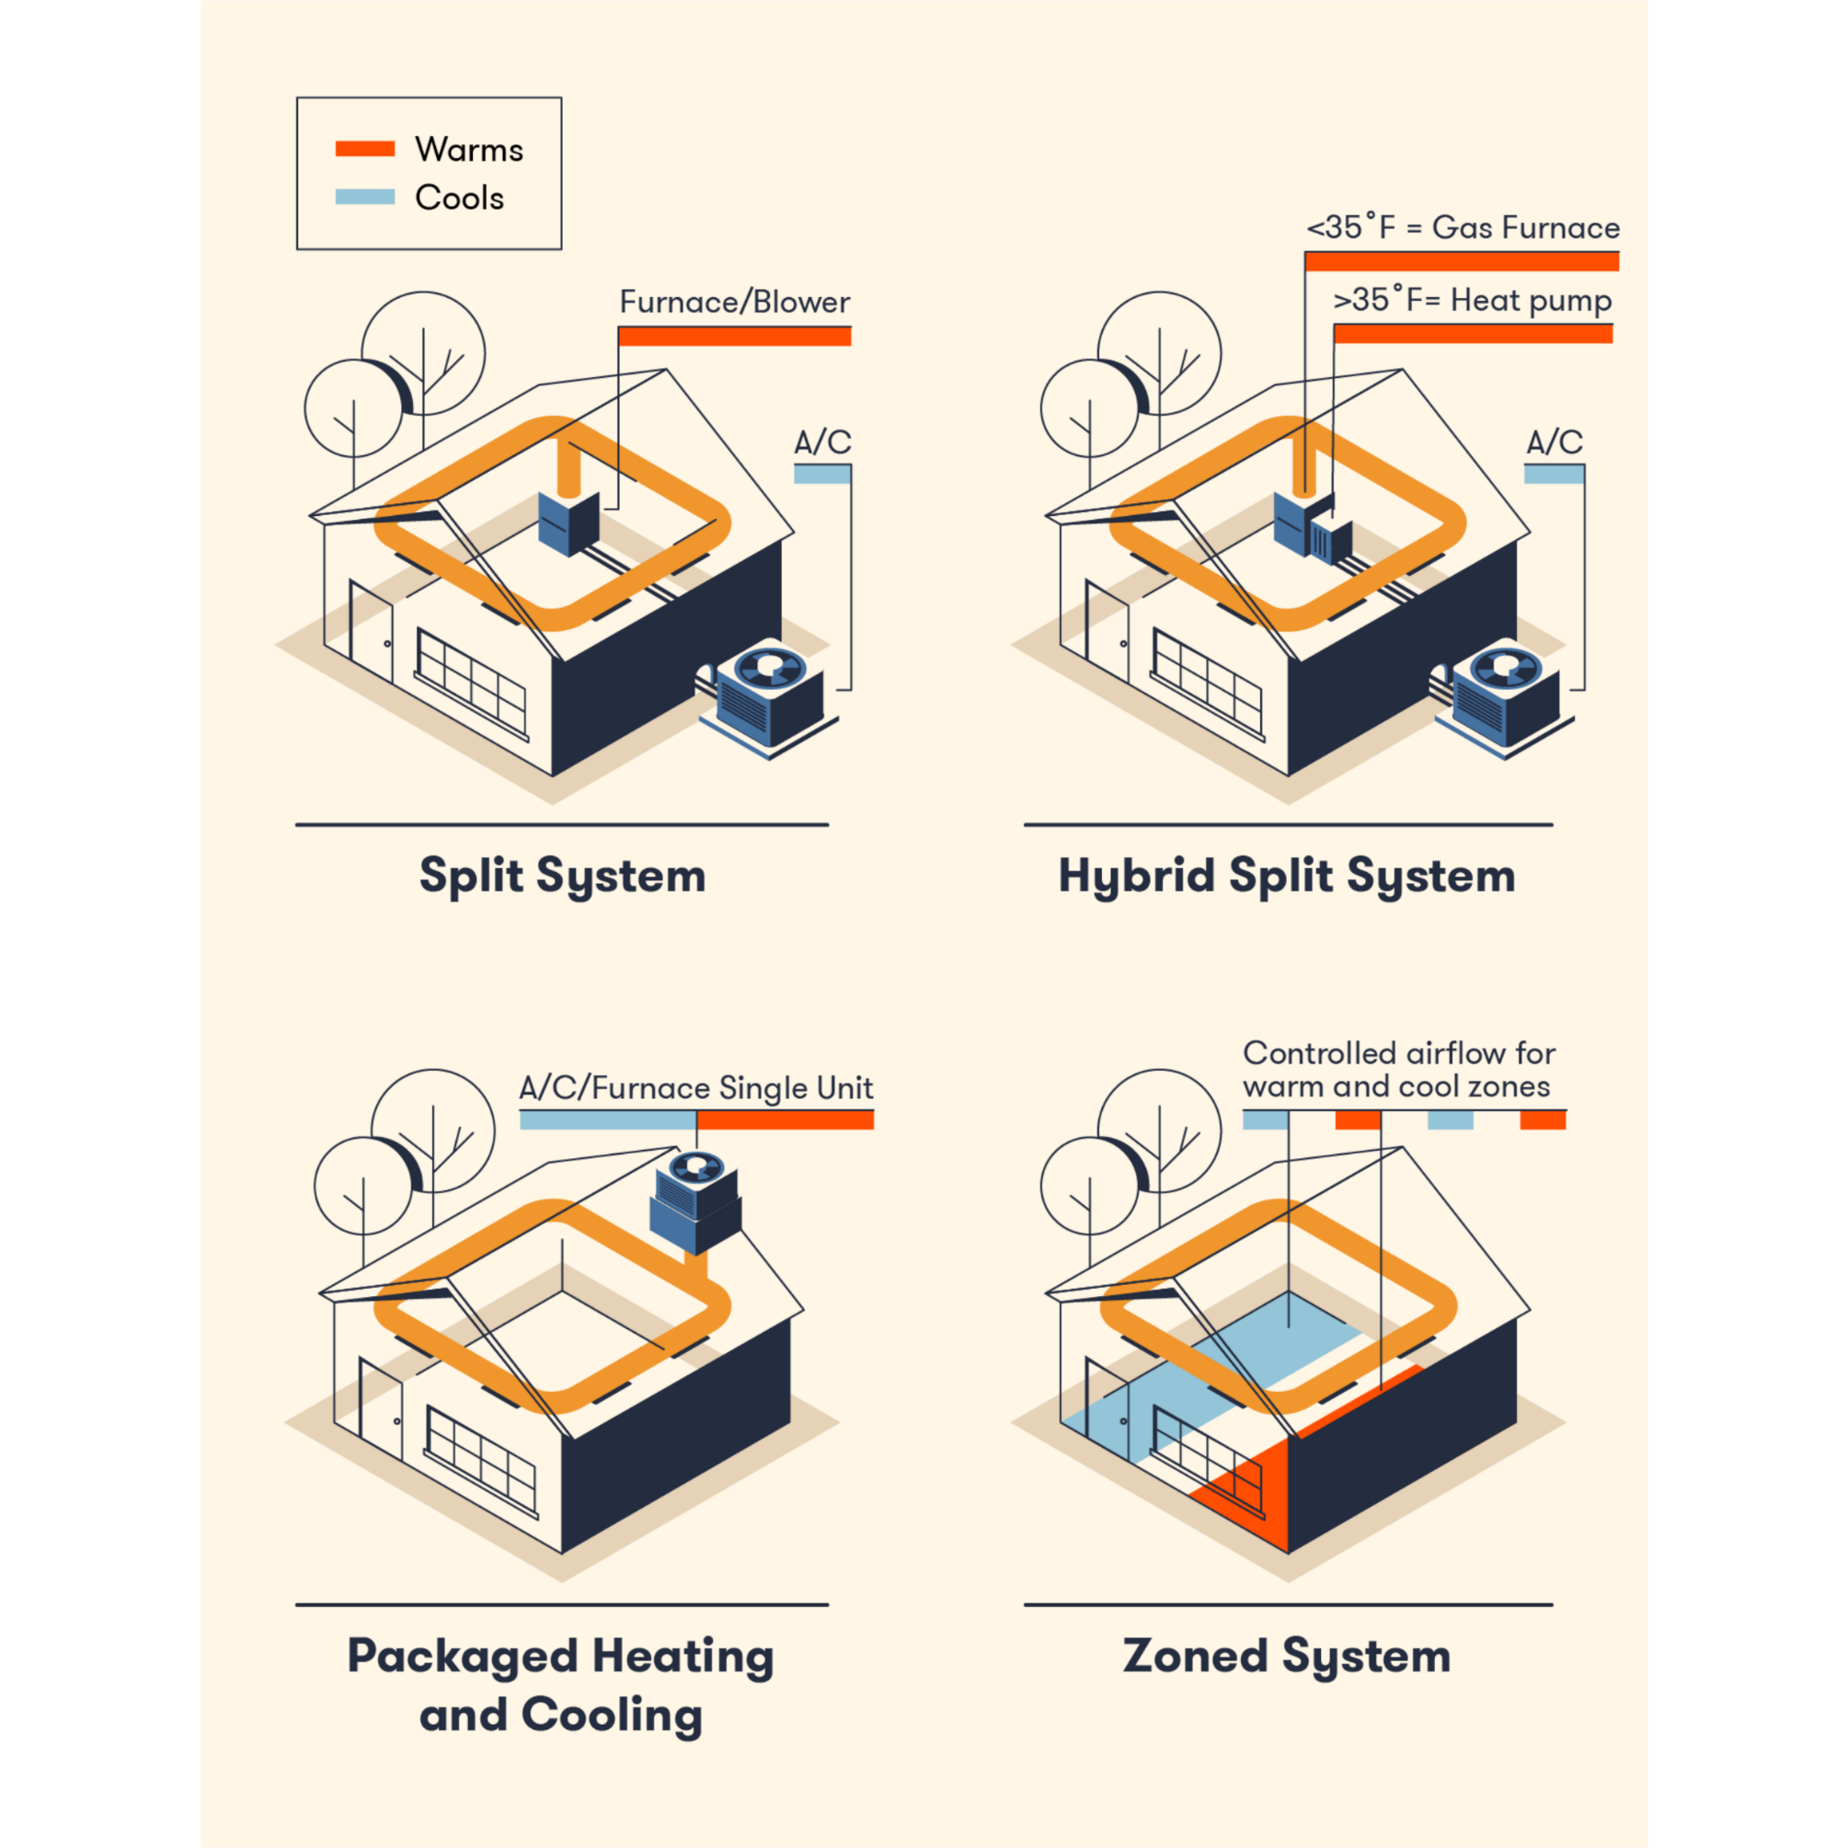
COMMON TYPES OF HVAC SYSTEMS
Types of Ducted HVAC systems
If a building uses vents to pump out hot and cold air, it is likely equipped with a ducted HVAC system. Ducted HVAC systems are standard in residential and commercial buildings and include any heating or cooling system that distributes air through a series of air ducts.

Slide 20
COMMON TYPES OF HVAC SYSTEMS
Split system: Classic comfort control
Split systems reign supreme in homes for climate control. They're like a tag team: one unit tackles heating (often gas-powered), the other handles cooling. A single thermostat acts as the commander, setting the temperature for your entire house. The heating unit usually lives in a basement or closet, while the cooling unit resides outdoors, connected by a network of pipes. The cooling unit uses clever tricks like compressors, coils, and refrigerant to generate cool air, while a fan directs hot air outside.
Key feature: one thermostat keeps the whole house comfortable.
Hybrid split system:
Saving energy with a gas and electric option
Think of a hybrid split system as a more flexible version of its classic counterpart. It shares the same cooling unit but offers a dual heating personality. It can utilize gas for powerful heating, but also has an electric mode. While electric heat might be slower and less intense, it gives you more control over energy use. This can be a cost-saver in areas with milder climates.
Key feature: offers flexibility and potentially lower energy bills.

Slide 21
COMMON TYPES OF HVAC SYSTEMS
Packaged heating and cooling:
While not as common as split systems, packaged systems are space-saving champs, ideal for smaller buildings. They combine both heating and cooling components into a single, compact unit. This unit typically finds a home on the roof, attic, or near the building's foundation. Installation and maintenance are often simpler compared to split systems, as they connect to the building's ductwork through just one opening. Depending on your climate, you can choose a packaged heat pump or a packaged air conditioner with optional heating elements.
Key feature: easy to install and maintain due to the all-in-one design.
Zoned system: tailored comfort for every room:
Big houses: separate HVAC systems per floor for complete control (but requires multiple units).
Most homes: Dampers (valves) in air ducts adjust airflow to different areas. Cooler zones get more air, keeping you comfy and saving energy.
Key Feature: provides individual temperature control for different areas.

Slide 22
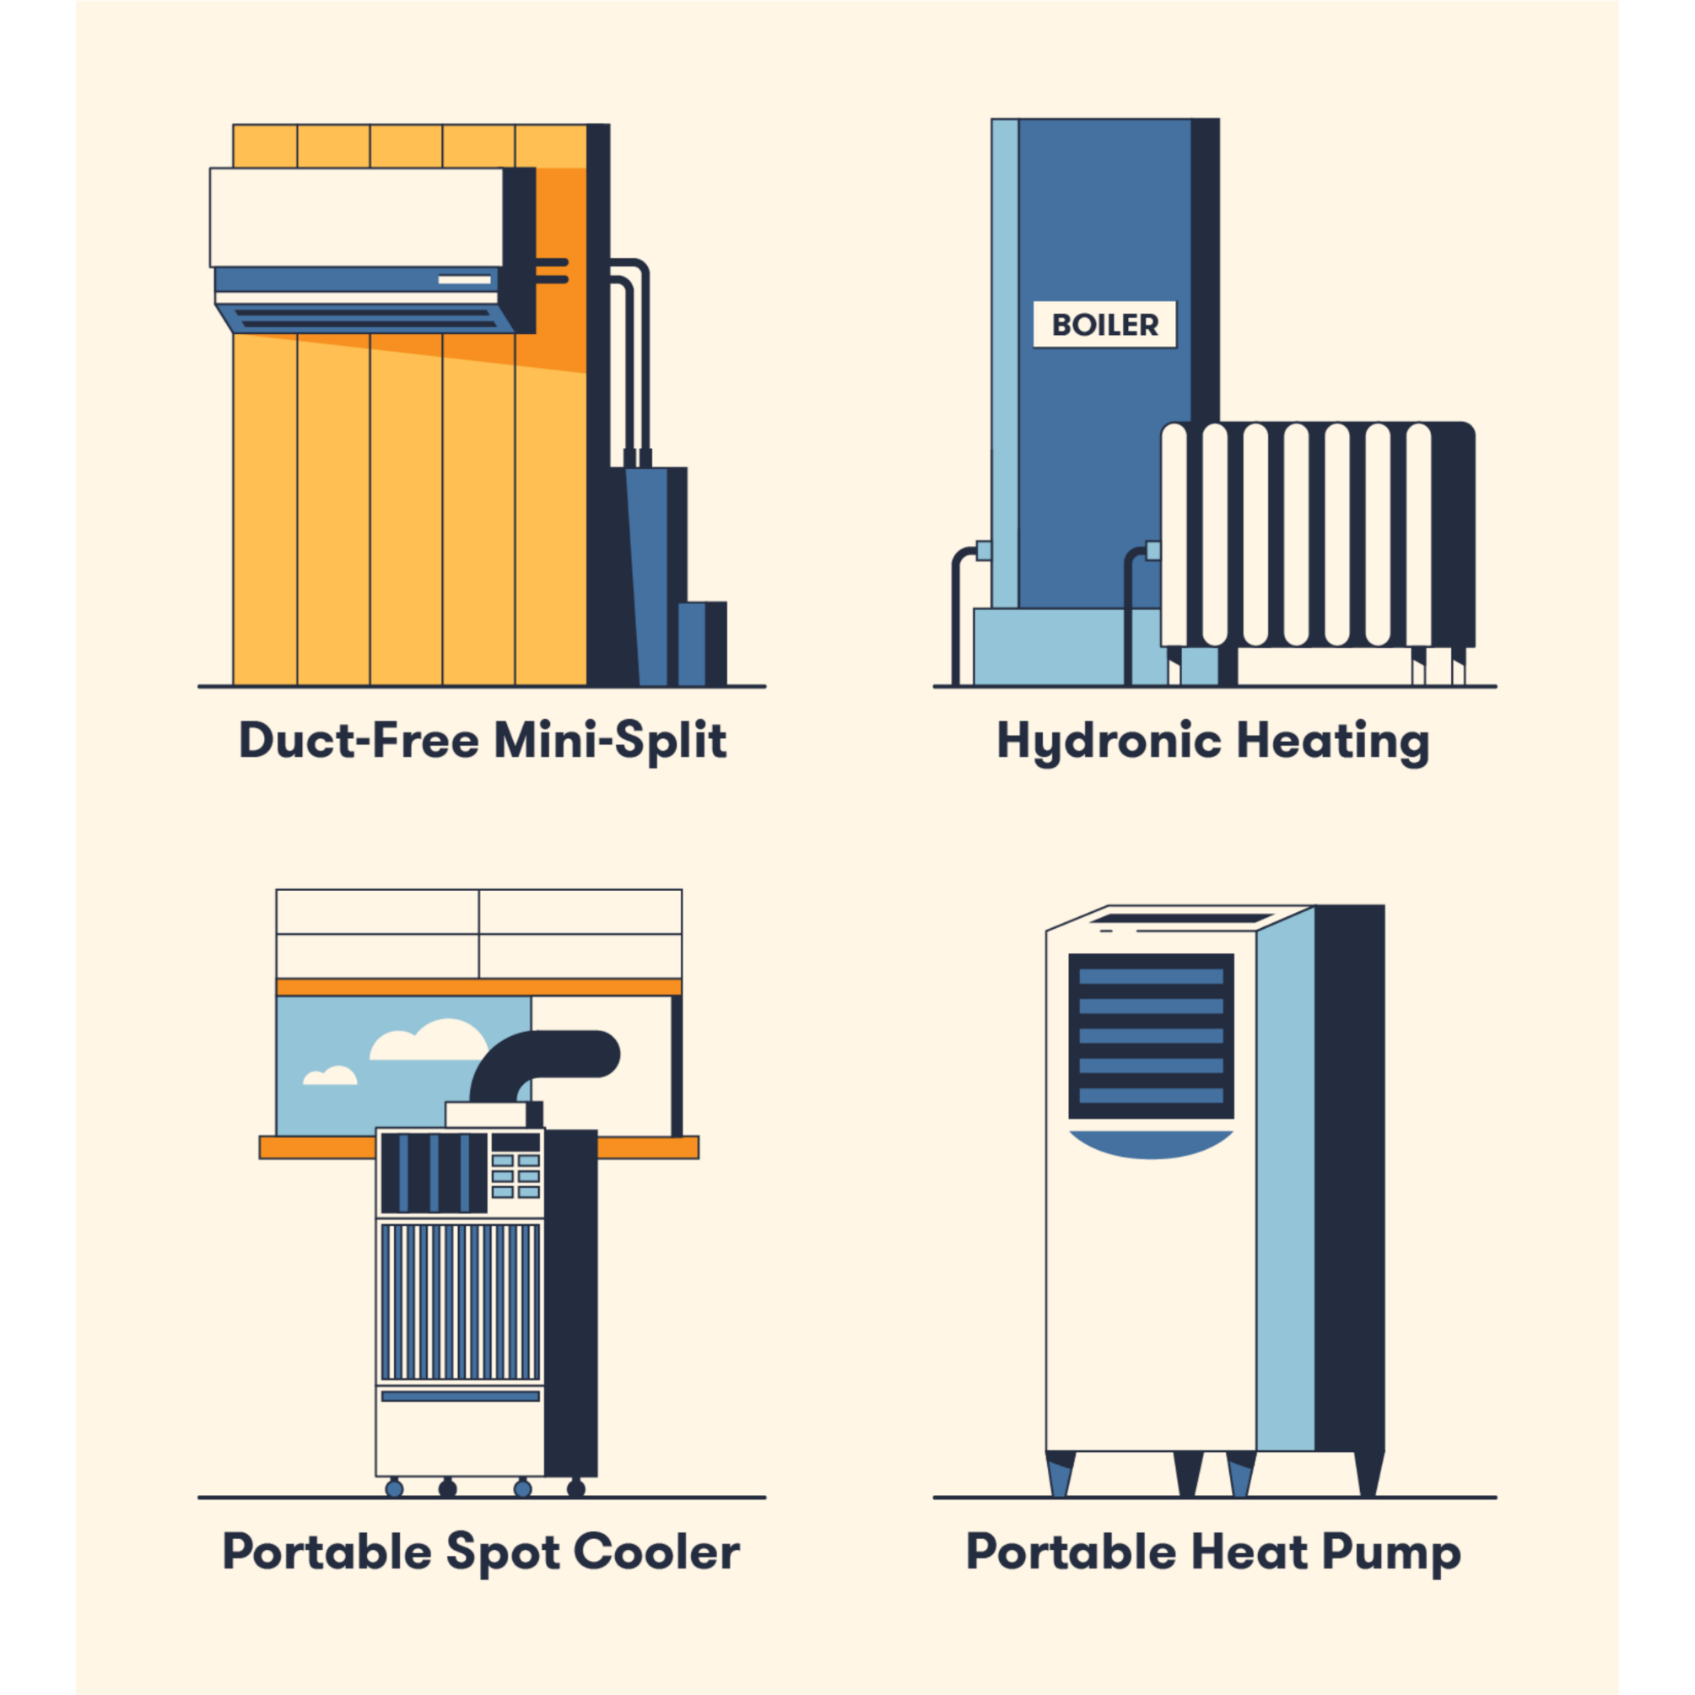
COMMON TYPES OF HVAC SYSTEMS
Types of Ductless HVAC systems
As the name suggests, ductless HVAC systems are designed to heat or cool a space without air ducts. These systems come in various sizes and are commonly used in small buildings or temporary work sites.

Slide 23
COMMON TYPES OF HVAC SYSTEMS
Duct-Free mini-split: customized comfort without the ducts
Mini-split AC cools specific rooms, perfect for apartments or unevenly heated homes. Powerful outdoor unit teams up with indoor units in each room for targeted comfort. Saves energy by avoiding leaky ducts, but a separate heater might be needed in very cold climates.
Key feature: offers individual room temperature control without ductwork
Hydronic heating: warmth from the inside out
Unlike traditional systems that use air, hydronic heating relies on the power of liquid to deliver warmth. A boiler acts like the heart of the system, heating water that then travels through pipes hidden under your floors. Once it reaches its destination (radiators, baseboards, or even radiant flooring), the hot water radiates heat throughout the room, creating a cozy feeling from the ground up.
Key Feature: uses heated liquid to radiate heat throughout a space.

Slide 24
COMMON TYPES OF HVAC SYSTEMS
Portable spot coolers: beat the heat on the go:
Spot coolers are portable AC units that cool large spaces like warehouses or events. They work like mini ACs, pulling in warm air, cooling it, and expelling hot air through a vent. They're flexible (plug-and-play with wheels) but require venting hot air outside to truly cool a space.
Key Feature: portable and easy to set up, perfect for temporary cooling needs.
Portable heat pumps: double duty for all seasons
Think of a portable heat pump as a Swiss Army knife of climate control. Similar in size and operation to a spot cooler, it offers both cooling and heating functions. In cooling mode, it works just like a spot cooler. But when you flip the switch to heating, it pulls in outside air, warms it up using a condenser coil, and distributes toasty comfort throughout the room. This versatility makes it a great choice for areas with fluctuating temperatures.
Key Feature: provides both heating and cooling in a portable unit.

Slide 25
10 of the most common HVAC problems and how to fix them
1. Dirty air
Dirty air filters are the most common culprit behind HVAC woes. A dirty filter restricts airflow, forcing your furnace to work harder. This can lead to overheating, premature wear, and uneven temperatures throughout your home. Replacing the filter is a simple task you can tackle yourself. Just ensure you get the right size for your system – your furnace manual should have that information.
2. Dirty ductwork
Dusty and grimy ductwork can spread pollutants throughout your house, reducing air quality and potentially triggering allergies or asthma. Regular cleaning is crucial. You can do it yourself or hire a professional. Video inspection cameras can help pinpoint areas needing the most attention.

Slide 26
10 of the most common HVAC problems and how to fix them
3. Malfunctioning thermostat
A malfunctioning thermostat could be the reason your furnace isn't behaving. Thermostats can be complex, but your owner's manual might have a troubleshooting section to help you identify and fix the problem. Sometimes, it's as simple as replacing the batteries! If that doesn't work, call a technician for assistance.
4. Tripped breakers and blown fuses
A complete loss of power could be due to a tripped breaker or blown fuse. Both often occur when your furnace is overworked, frequently caused by a clogged air filter. Start by replacing the filter. If the problem persists, call a technician to address the issue.
5.Dirty condenser or evaporator coils
Without regular maintenance, your system's ability to heat or cool effectively might decline. Dirty condenser and evaporator coils are likely the culprit. You can hose down the outdoor condenser coil (with the power off!), but extremely dirty coils might require professional cleaning.

Slide 27
10 of the most common HVAC problems and how to fix them
6. Water leaks from the unit
Air conditioners and furnaces produce condensation that drains through pipes. Clogged pipes can cause water to back up and leak from the unit. Try pouring bleach down the drain pipes to clear clogs. If the leak persists, call a professional right away.
7. Uneven room temperatures
Uneven temperatures from room to room can be caused by problems with your HVAC zoning. Ideally, your ducts should deliver conditioned air evenly throughout the house. In some cases, ductwork redesign might be necessary. Often, adjustments can be made to improve temperature distribution.
8. Negative pressure
Negative pressure occurs when outside air pressure is higher than inside pressure. This can impact efficiency and comfort. Unfiltered, unconditioned air gets pulled into your home, reducing both comfort and air quality. Diagnosing the cause can be tricky; it could be a fan speed setting, cracks in the vents, or other factors. Consulting a professional is recommended for this issue.

Slide 28
10 of the most common HVAC problems and how to fix them
9. Leaky ducts
Leaks in your ductwork can force your system to work harder to deliver enough conditioned air. This not only makes your home uncomfortable but also leads to higher energy bills. A Data Logging airflow volume hot wire anemometer can help identify leaks for targeted repairs. Consider seeking professional help for diagnosing and fixing leaky ducts.
10. Problems with pilot light and ignition
Your furnace's ignition system relies on specific elements working in harmony. A malfunctioning pilot light, flame sensor, or burner can prevent ignition. This requires professional diagnosis and repair. Don't attempt to fix it yourself, as gas and high-voltage electricity are involved.

Slide 29
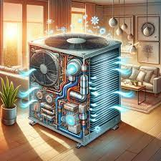
EDUCATIONAL VIDEOS
1. What is HVAC?
2. HVAC Training - Basics of HVAC

Slide 30
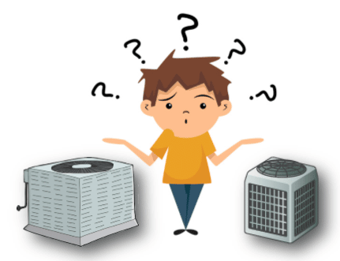
QUESTIONS FOR SELF-CONTROL
Scan me!

